Slide 1


K J Somaiya College of Engineering, Mumbai-77
(Constituent college of Somaiya Vidyavihar University)
Sentiment AI: Twitter Sentiment Analysis
Presented by:
Ehsaas Sam
Khushi Choudhary
Guided by:
Prof. Sushma Kadge
Dr. Sudha Gupta

Slide 2
Problem Statement
Limitations of Existing Tools: Current sentiment analysis tools are unreliable for Twitter data, resulting in inaccuracies and restricting the depth of insights obtained.
Diverse Expression Styles: Twitter encompasses a wide range of expression styles, such as slang and memes, which pose challenges for traditional sentiment models and necessitate a more nuanced approach.
Challenges with Informal Language: Traditional sentiment analysis models struggle to handle the informal language prevalent on Twitter, impacting the accuracy of sentiment analysis and opinion mining.
Adaptability to Dynamic Language: The dynamic nature of language evolution on Twitter demands adaptable sentiment analysis solutions to effectively capture evolving language trends and sentiments.

Slide 3
Abstract
Objective: Develop a robust sentiment analysis system to analyze Twitter data for understanding public sentiment towards various subjects, brands, or events.
Approach: Utilize natural language processing and deep learning techniques, including LSTM and CNN algorithms, for efficient sentiment classification.
Impact: Provide businesses, marketers, researchers, and policymakers with actionable insights to monitor brand reputation, assess customer satisfaction, and gauge public opinion.
Highlight: By leveraging advanced deep learning models, our project aims to revolutionize social media analytics and empower decision-makers with real-time sentiment insights from Twitter data.

Slide 4
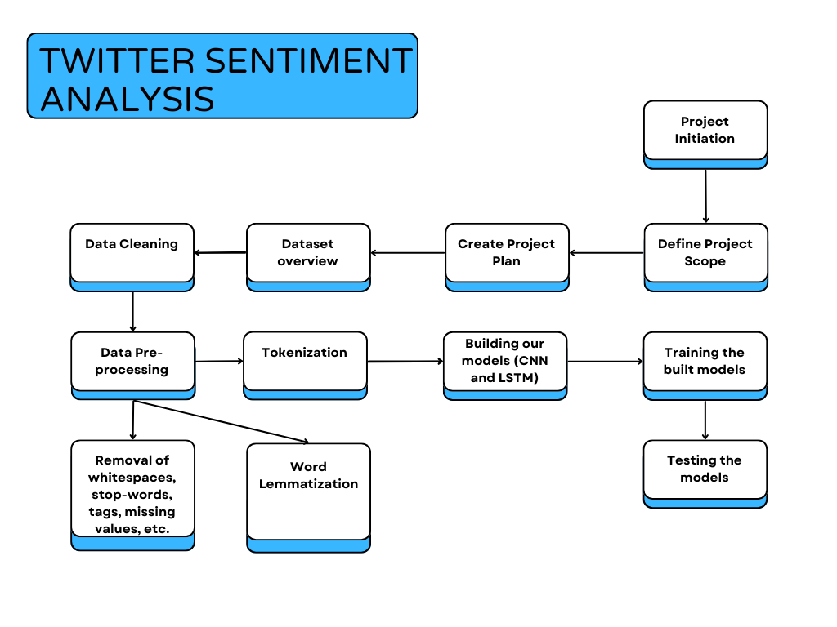
Flow of Project

Slide 5
Literature Survey
Title | Author, Year | Methodology Used | Classifiers Used | Results | Gaps Identified | Dataset Used
Feature-Based Twitter Sentiment Analysis With Improved Negation Handling | Itisha Gupta and Nisheeth Joshi, 2021 | Tokenization, POS Tagging, Feature Engineering | Support Vector Machine, Naive Bayes, Decision Trees | F1 Score - 69.5 | Poor feature vector size and negation handling | SemEval-2013 Twitter corpus for the Twitter sentiment analysis (TSA) task
Real Time Sentiment Analysis Of Twitter Posts | Prakruthi V, Sindhu D, Dr S Anupama Kumar, 2018 | Tokenization, Stop Word Removal, Bag of Words | Naive Bayes, Logistic Regression, SVM, Random Forest | Visualization of results using Histogram and Pie Chart | Bag of words used for sentiment analysis, Emoticons not analyzed for sentiment classification | Live tweets retrieved using Twitter API

Slide 6
Literature Survey
Title | Author, Year | Methodology Used | Classifiers Used | Results | Gaps Identified | Dataset Used
Sentiment Analysis of Lockdown in India During COVID-19: A Case Study on Twitter | Prasoon Gupta , Sanjay Kumar, R. R. Suman, and Vinay Kumar, 2021 | Used python libraries: Scikit Learn NLTK Pandas Matplotlib | Multinomial Naive-Bayes, Bernoulli Naive Bayes, Logistic Regression, Linear SVC, AdaBoost Classifier, Ridge Classifier, and Perceptron | 84.4 was observed with the LinearSVC classifier using unigrams. | Impact of fake news, Absence of Model Evaluation, Temporal Analysis | Tweepy API of Twitter to extract tweets for the analysis
Twitter Sentiment Analysis Based on Ordinal Regression | Shihab Elbagir, Jing Yang, 2019 | Pre-processing and feature extraction of tweets, Classification using machine learning algorithms | Multinomial logistic regression, Support Vector Regression (SVR) | RF Accuracy - 83.2% SoftMax Accuracy - 67.2% | Investigate different machine learning and deep learning techniques, Improve approach by using bigrams and trigrams | NLTK corpora resources (Twitter dataset)

Slide 7
Dataset Overview
Sentiment140 dataset
It contains 1,600,000 tweets extracted using the twitter api . The tweets have been annotated (0 = negative, 2 = neutral, 4 = positive) and they can be used to detect sentiment .
It contains the following 6 fields:
target: the polarity of the tweet (0 = negative, 2 = neutral, 4 = positive)
ids: The id of the tweet ( 2087)
date: the date of the tweet (Tue Oct 03 23:58:44 UTC 2023)
flag: The query (lyx). If there is no query, then this value is NO_QUERY.
user: the user that tweeted (khushii27, ehsaas11)
text: the text of the tweet (Alice is the best, Bob is not the best.)

Slide 8
Data Preprocessing
Tokenization:
Breaks text into individual words or tokens.
Example: "The quick brown fox" becomes ["The", "quick", "brown", "fox"].
Utilize NLP libraries like NLTK or spaCy for tokenization.
Word2Vec Embeddings:
Represents words as dense vectors in a continuous space.
Created using pre-trained models or trained on large text corpora.
Captures semantic relationships between words for sentiment analysis.
Remove Numbers, Links, Punctuations, Whitespace:
Cleans text data by removing numbers, links, punctuations, and extra whitespace.
Utilize regular expressions for efficient removal.
Word Lemmatization:
Reduces words to their base or dictionary form (lemmas).
Example: "running" becomes "run", "better" becomes "good".
Standardizes text and reduces feature space dimensionality.
Implemented using libraries like NLTK or spaCy.
Notes:
Data preprocessing is a crucial step in preparing text data for sentiment analysis or any natural language processing (NLP) task. The steps mentioned ahead are common preprocessing techniques, and they can help improve the quality of your data before feeding it into a machine learning model.

Slide 9
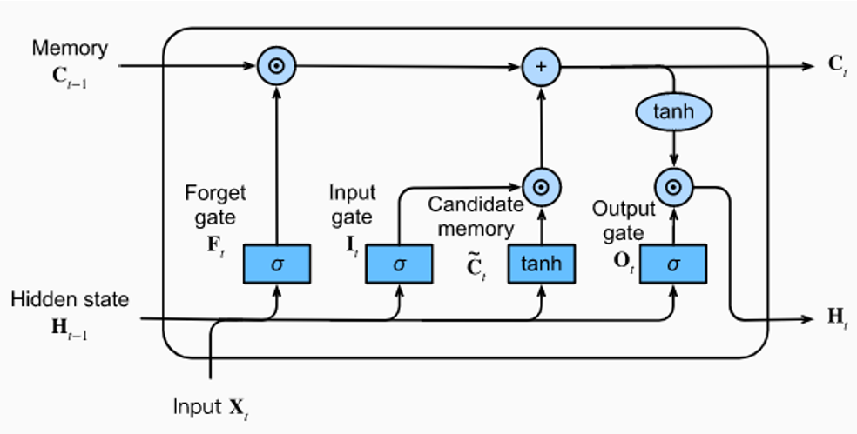
Models Used - LSTM
LSTM
LSTM is a type of recurrent neural network (RNN) architecture designed to capture long-range dependencies in sequential data.
Working of LSTM:
Cell State: The LSTM's "memory" spans sequences, enabling it to retain pertinent information over time by selectively updating and propagating information between time steps.
Input Gate: This gate manages new data input by using a sigmoid activation function to determine how much of each component should be updated, based on values between 0 and 1.
Forget Gate: Responsible for removing irrelevant data, the forget gate utilizes a sigmoid activation function to decide which data from the cell state should be forgotten.
Output Gate: Controls the output information transfer from the cell state to the output using a pointwise multiplication operation and hyperbolic tangent (tanh) activation function.

Slide 10
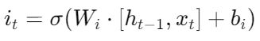
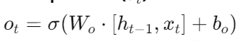
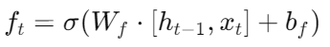
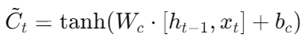
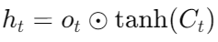
Formulas Used - LSTM
1. Input Gate
4. Candidate Cell State
2. Forget Gate
5. Cell State
3. Output Gate
6. Hidden State
Where,
x_{t} represents the input vector at time step 𝑡.
h_{t-1} denotes the hidden state vector from the previous time step.
represents the sigmoid activation function.
W_{i}, W_{f}, W_{o}, and W_{c} are weight matrices for the input, forget, output, and candidate cell state, respectively.
b_{i}, b_{f}, b_{o}, and b_{c} are bias vectors

Slide 11
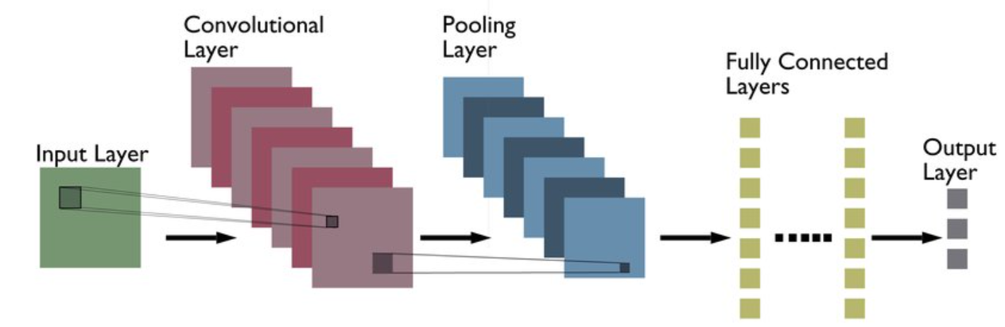
Models Used - CNN
Convolutional Neural Networks (CNNs) are advanced deep learning architectures widely used for processing sequential data such as text. They consist of several key components that work together to extract and process features from input data.
Components of CNN Architecture:
Convolutional Operations: These operations involve passing input data through small filters or kernels to generate feature maps, which highlight relevant patterns and structures.
Activation Functions (e.g., ReLU): Activation functions introduce non-linearity to the network, enabling it to capture complex interactions between features and improve learning capacity.
Pooling Layers: Pooling layers, typically positioned after convolutional layers, downsample feature maps to improve translation invariance and reduce computational complexity.
Fully Connected Layers: These layers receive flattened feature maps and learn to combine features from different spatial locations for classification tasks.

Slide 12
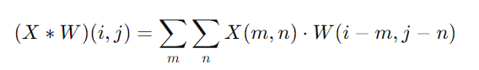
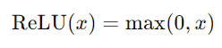
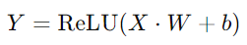
Formulas Used - CNN
1. Convolution Operation:
The convolution operation between an input image X and a filter W at position (i, j) is calculated as:
where (X(m, n)) represents the pixel intensity of the input image at position (m, n) and (W(i - m, j - n)) represents the weight of the filter at position (i - m, j - n).
2. Pooling Operation:
Max Pooling: The max pooling operation takes the maximum value within a local region of the input feature map. For a 2x2 pooling window, the operation is defined as:
3. Activation Functions:
ReLU (Rectified Linear Unit): The ReLU activation function is commonly used in CNNs and is defined as:
4. Fully Connected Layer:
The output of the convolutional and pooling layers is flattened before being passed through a fully connected layer. If X is the flattened input vector and W is the weight matrix of the fully connected layer, the output Y is calculated as:
where b is the bias vector.

Slide 13
Performance Parameters Used
Accuracy: Accuracy measures the proportion of correctly classified instances out of the total instances. It offers a general overview of the model's correctness but may not be ideal for imbalanced datasets.
Precision: Precision quantifies the accuracy of positive predictions made by the model. It is calculated as the ratio of true positive predictions to the sum of true positives and false positives.
Recall: Recall, also known as sensitivity or true positive rate, measures the model's ability to identify all positive instances. It is calculated as the ratio of true positive predictions to the sum of true positives and false negatives.
F1 Score: F1 score is the harmonic mean of precision and recall, providing a balanced measure of a model's performance. It considers both false positives and false negatives, making it suitable for imbalanced datasets.
ROC-AUC (Receiver Operating Characteristic - Area Under the Curve): ROC-AUC evaluates the model's ability to distinguish between positive and negative classes across various threshold values. Higher values indicate better discrimination ability of the model.

Slide 14
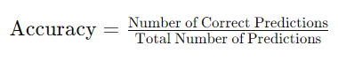
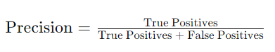
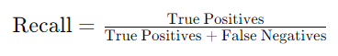
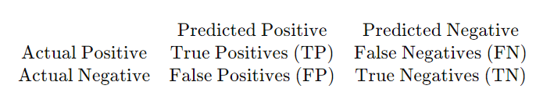
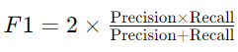
Performance Parameters Used
Accuracy: It the ratio of correct predictions to total predictions, representing the overall correctness of the model.
Precision: It the accuracy of positive predictions by measuring the ratio of true positive predictions to all positive predictions.
Recall (Sensitivity): measures the model's ability to capture all positive instances by calculating the ratio of true positive predictions to all actual positive instances.
F1-Score: The F1-score is the harmonic mean of precision and recall and is useful when the class distribution is imbalanced.
5. ROC AUC (Receiver Operating Characteristic Area Under Curve): ROC AUC quantifies the model's ability to discriminate between positive and negative classes across various threshold values. It plots the true positive rate (sensitivity) against the false positive rate (1 - specificity) and calculates the area under the curve. Higher ROC AUC values indicate better discrimination performance.
6. Confusion Matrix: A confusion matrix provides a tabular summary of the model's predictions versus the actual labels in the dataset. It includes true positives (TP), true negatives (TN), false positives (FP), and false negatives (FN), which can be used to calculate various performance metrics.

Slide 15
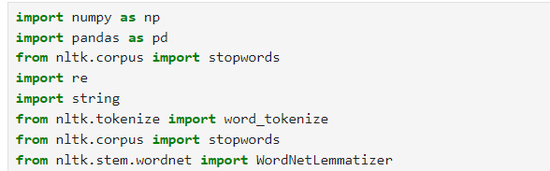
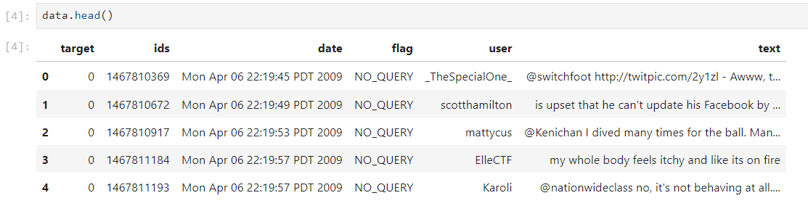
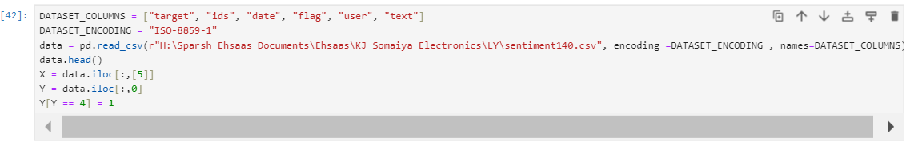
Implementation
Importing the Necessary Modules
Dataset
Loading the Dataset
Notes:
Data preprocessing is a crucial step in preparing text data for sentiment analysis or any natural language processing (NLP) task. The steps mentioned ahead are common preprocessing techniques, and they can help improve the quality of your data before feeding it into a machine learning model.

Slide 16
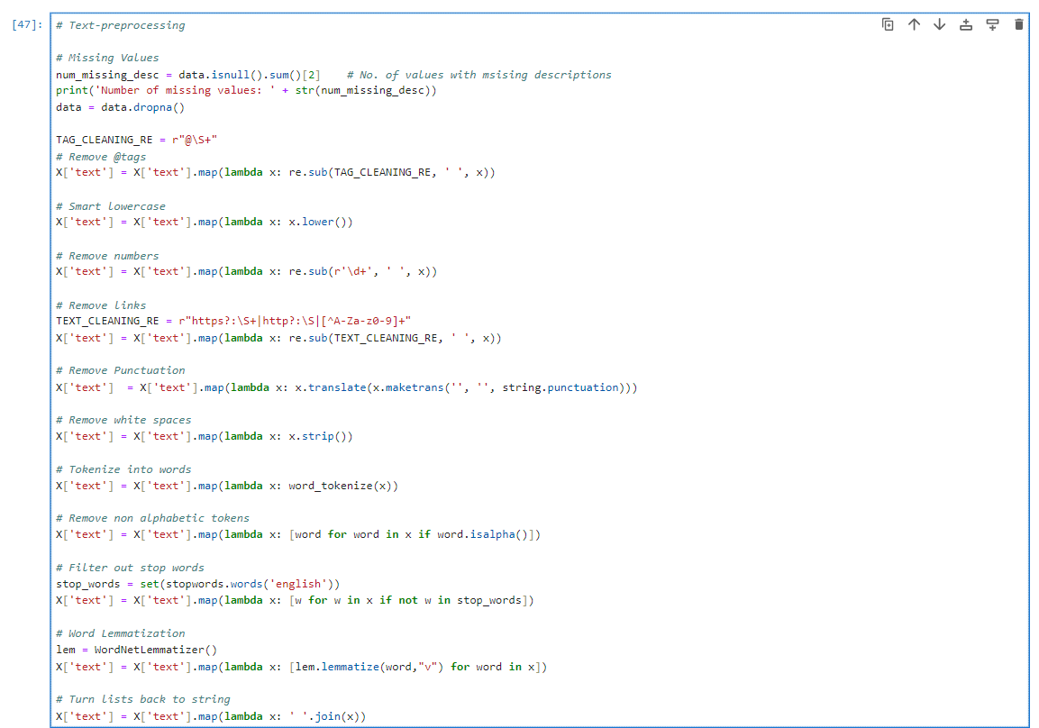
Implementation
Text Preprocessing
Notes:
Data preprocessing is a crucial step in preparing text data for sentiment analysis or any natural language processing (NLP) task. The steps mentioned ahead are common preprocessing techniques, and they can help improve the quality of your data before feeding it into a machine learning model.

Slide 17
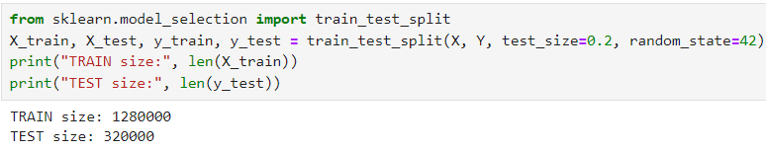
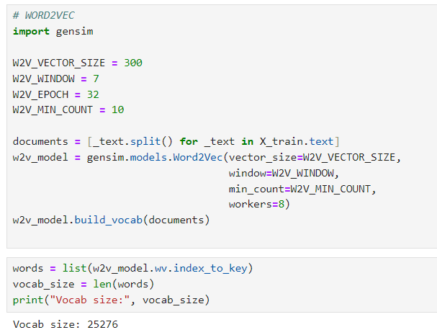
Implementation
Splitting the model into training and testing
Word2Vec and building Vocab
Notes:
Data preprocessing is a crucial step in preparing text data for sentiment analysis or any natural language processing (NLP) task. The steps mentioned ahead are common preprocessing techniques, and they can help improve the quality of your data before feeding it into a machine learning model.

Slide 18
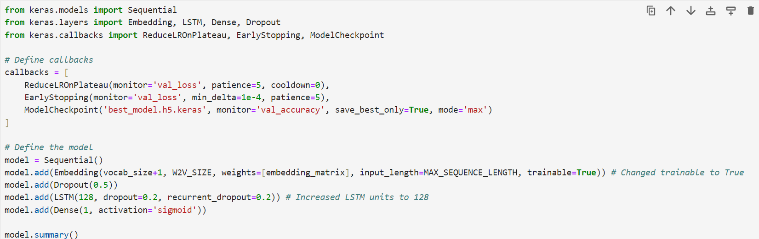
Building the LSTM Model
Notes:
Data preprocessing is a crucial step in preparing text data for sentiment analysis or any natural language processing (NLP) task. The steps mentioned ahead are common preprocessing techniques, and they can help improve the quality of your data before feeding it into a machine learning model.

Slide 19
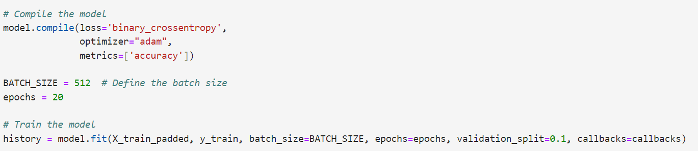
Training the LSTM Model
Notes:
Data preprocessing is a crucial step in preparing text data for sentiment analysis or any natural language processing (NLP) task. The steps mentioned ahead are common preprocessing techniques, and they can help improve the quality of your data before feeding it into a machine learning model.

Slide 20
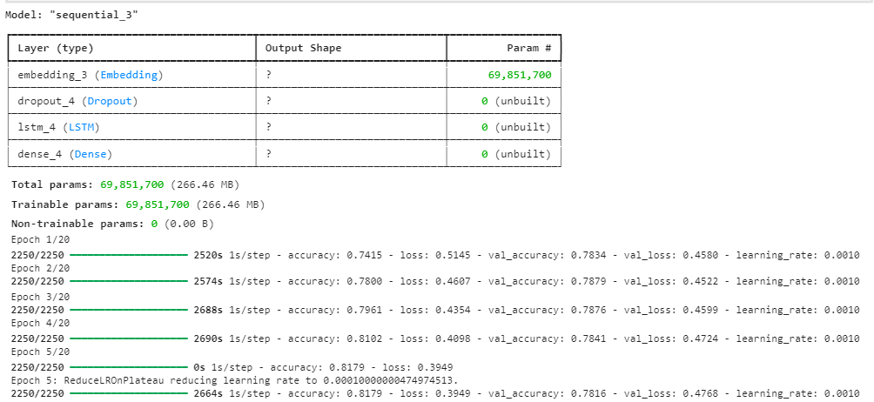
Training the LSTM Model
Notes:
Data preprocessing is a crucial step in preparing text data for sentiment analysis or any natural language processing (NLP) task. The steps mentioned ahead are common preprocessing techniques, and they can help improve the quality of your data before feeding it into a machine learning model.

Slide 21
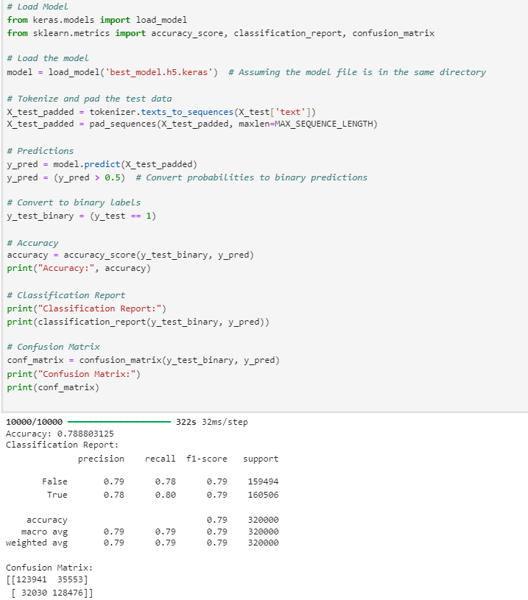
Testing the LSTM Model
Notes:
Data preprocessing is a crucial step in preparing text data for sentiment analysis or any natural language processing (NLP) task. The steps mentioned ahead are common preprocessing techniques, and they can help improve the quality of your data before feeding it into a machine learning model.

Slide 22
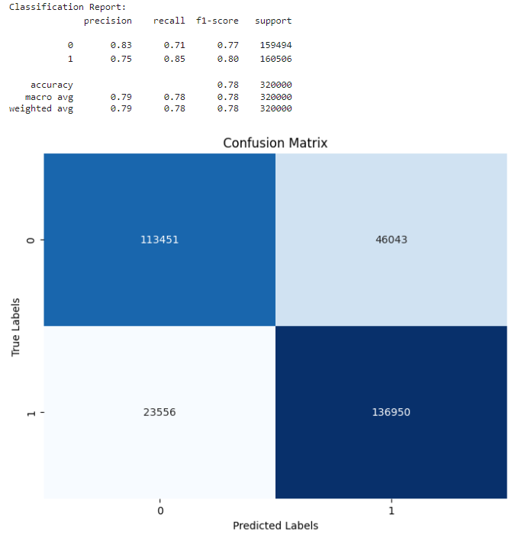
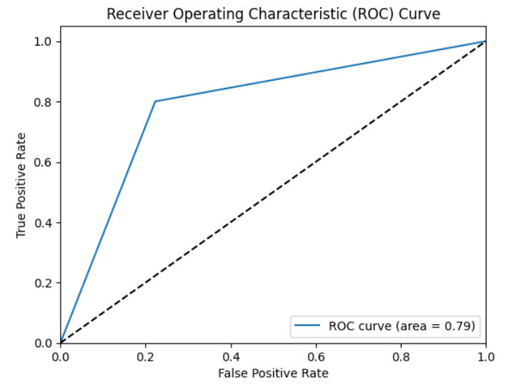
Evaluating the LSTM Model
Notes:
Data preprocessing is a crucial step in preparing text data for sentiment analysis or any natural language processing (NLP) task. The steps mentioned ahead are common preprocessing techniques, and they can help improve the quality of your data before feeding it into a machine learning model.

Slide 23
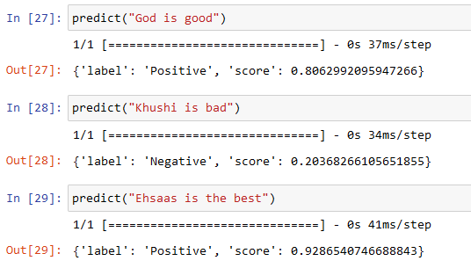
Outputs - LSTM Model
Notes:
Data preprocessing is a crucial step in preparing text data for sentiment analysis or any natural language processing (NLP) task. The steps mentioned ahead are common preprocessing techniques, and they can help improve the quality of your data before feeding it into a machine learning model.

Slide 24
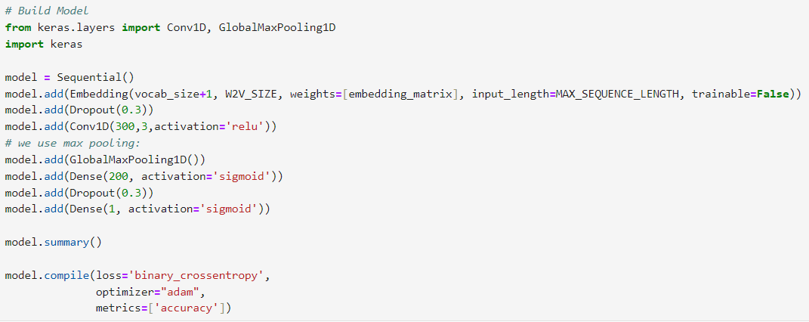
Building the CNN Model
Notes:
Data preprocessing is a crucial step in preparing text data for sentiment analysis or any natural language processing (NLP) task. The steps mentioned ahead are common preprocessing techniques, and they can help improve the quality of your data before feeding it into a machine learning model.

Slide 25
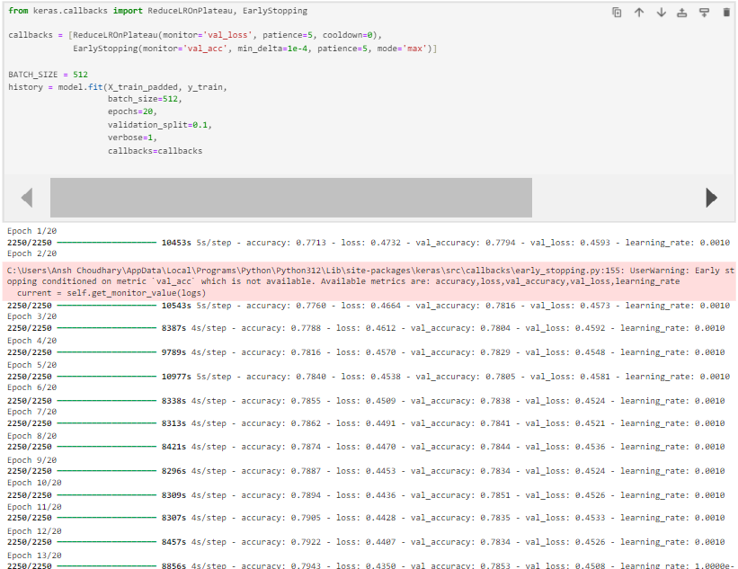
Training the CNN Model
Notes:
Data preprocessing is a crucial step in preparing text data for sentiment analysis or any natural language processing (NLP) task. The steps mentioned ahead are common preprocessing techniques, and they can help improve the quality of your data before feeding it into a machine learning model.

Slide 26
Training the CNN Model
Notes:
Data preprocessing is a crucial step in preparing text data for sentiment analysis or any natural language processing (NLP) task. The steps mentioned ahead are common preprocessing techniques, and they can help improve the quality of your data before feeding it into a machine learning model.

Slide 27
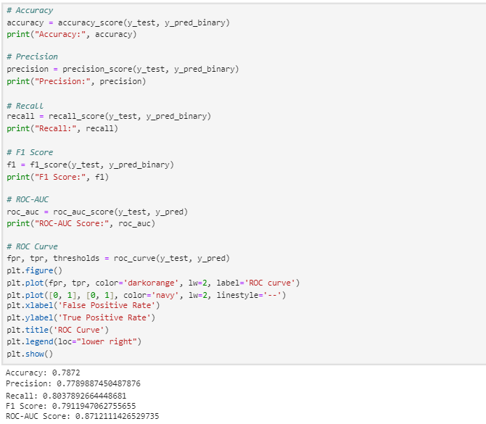
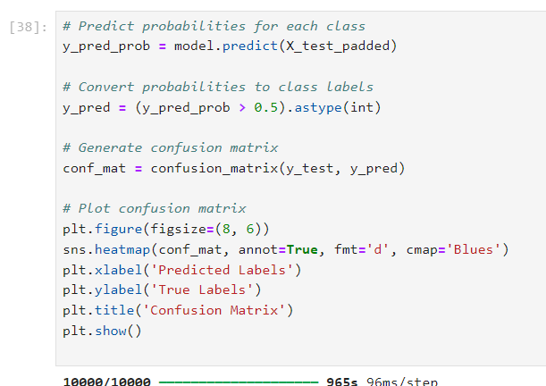
Testing the CNN Model
Notes:
Data preprocessing is a crucial step in preparing text data for sentiment analysis or any natural language processing (NLP) task. The steps mentioned ahead are common preprocessing techniques, and they can help improve the quality of your data before feeding it into a machine learning model.

Slide 28
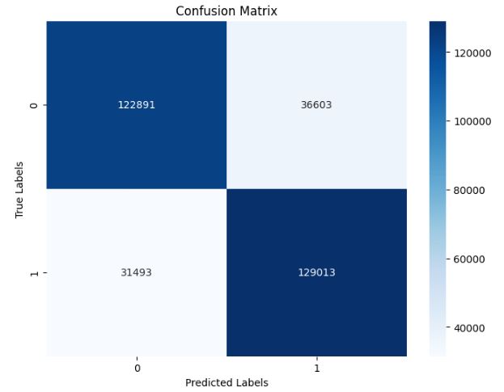
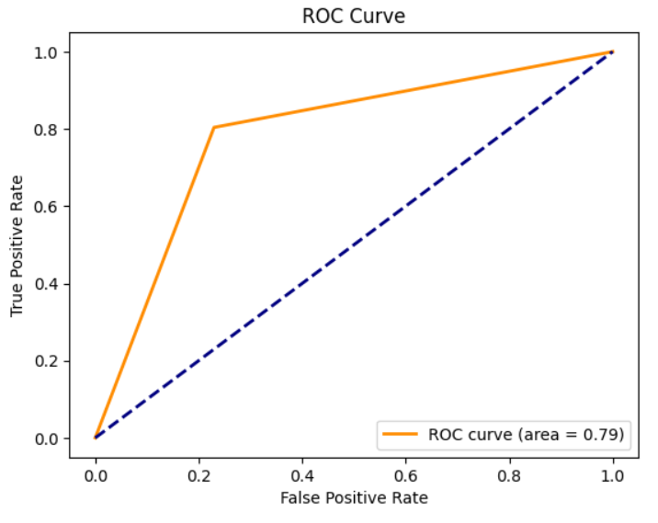
Evaluating the CNN Model
Accuracy: 0.7872
Precision: 0.7789887450487876
Recall: 0.8037892664448681
F1 Score: 0.7911947062755655

Slide 29
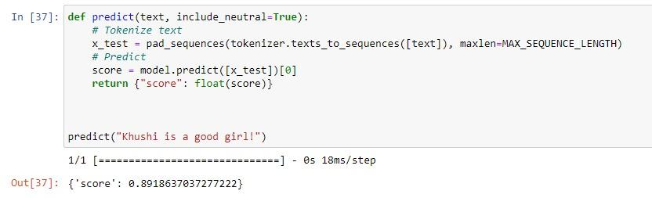
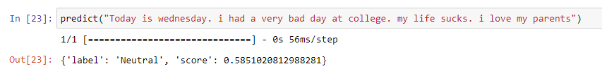
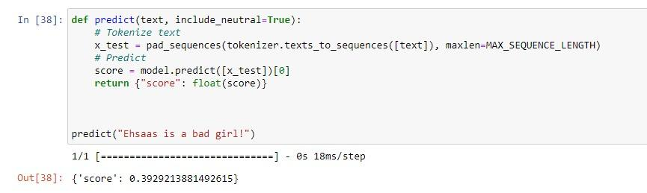
Outputs - CNN Model

Slide 30






Application
1. Brand Monitoring
3. Political Analysis
5. Influencer Marketing
2. Product Development
4. Competitor Analysis
6. Educational Research
Notes:
Our future work encompasses several key areas of development. We are committed to enhancing sentiment analysis accuracy through the application of advanced techniques. Data preprocessing will remain a priority to ensure the quality of our input data. Additionally, we will focus on validating the authenticity and reliability of our sentiment analysis model. To enhance accessibility and usability, we plan to create a web API for our sentiment analysis system, allowing for seamless integration and user-friendly access.

Slide 31
Further Works
Enhancing Sentiment Analysis Accuracy: Application of advanced techniques.
Data Preprocessing Priority: Ensuring high-quality input data.
Taking emoticons into consideration: Considering emojis to analyse the sentiments
Model Authenticity and Reliability Validation: Ensuring trustworthy sentiment analysis results.
Creating a Web API: Enhancing Accessibility and Usability, Seamless integration and user-friendly access.
Notes:
Our future work encompasses several key areas of development. We are committed to enhancing sentiment analysis accuracy through the application of advanced techniques. Data preprocessing will remain a priority to ensure the quality of our input data. Additionally, we will focus on validating the authenticity and reliability of our sentiment analysis model. To enhance accessibility and usability, we plan to create a web API for our sentiment analysis system, allowing for seamless integration and user-friendly access.

Slide 32
References
Feature-Based Twitter Sentiment Analysis With Improved Negation Handling | IEEE Journals & Magazine
Real Time Sentiment Analysis Of Twitter Posts | IEEE Conference Publication
Sentiment Analysis of Lockdown in India During COVID-19: A Case Study on Twitter | IEEE Journals & Magazine
The effect of preprocessing techniques on Twitter sentiment analysis | IEEE Conference Publication
Sentiment Analysis with LSTM - Analytics Vidhya
https://jupyter.org/
https://packaging.python.org/en/latest/tutorials/installing-packages/
https://www.geeksforgeeks.org/twitter-sentiment-analysis-using-python/
Notes:
Our future work encompasses several key areas of development. We are committed to enhancing sentiment analysis accuracy through the application of advanced techniques. Data preprocessing will remain a priority to ensure the quality of our input data. Additionally, we will focus on validating the authenticity and reliability of our sentiment analysis model. To enhance accessibility and usability, we plan to create a web API for our sentiment analysis system, allowing for seamless integration and user-friendly access.

Slide 33
THANK YOU

